Slide 1

IDEAS-TIH INTERNSHIP PRESENTATION
Resource Management System Software
UNDER THE GUIDANCE OF ADRIJA DAS
Presentation by
Ankush Chowdhury, B.Tech. Information Technology, 2nd Year (pursuing 3rd year), MCKV Institute of Engineering, Howrah
Adrika Bose, B.Sc. (Hons.) Statistics, 2nd Year (pursuing 3rd year), St. Xavier’s College (Autonomous), Kolkata

Slide 2
Introduction
Resource management plays a vital role in optimizing device usage within institutions.
Organizations often face issues managing devices like desktops across different employees.
This project addresses such challenges by providing a web-based software system. Built using Streamlit for the frontend and DuckDB for the backend.
Helps track ownership, sharing status, and memory details of computing devices. Simplifies admin operations like adding, updating, and deleting devices.

Slide 3
Problem Statement
Institutions lack centralized control for managing computing resources efficiently.
Traditional systems involve manual entry, miscommunication, and scattered records. Difficulty in sharing desktops fairly among employees.
No visibility into which devices are currently in use, shared, or idle.
Need for a user-friendly tool for both Admins and Users to manage resources.

Slide 4
Objective
Build a web-based solution for device resource management.
Enable admins to add, update, share, or delete desktops. Auto-assign non-repetitive Employee IDs to users/admins. Visualize sharing of desktops through a calendar.
Provide dashboards tailored to Admin and User roles.
Maintain a consistent and lightweight database using DuckDB.

Slide 5
Tools & Technologies Used
Frontend:
Streamlit (Python-based web app framework) Backend:
DuckDB (lightweight, embedded OLAP database) Others:
GitHub (Version control)
Python libraries: Pandas, Plotly, Streamlit Calendar
Random module for non-repeating employee ID generation Simple, portable, and efficient tech stack

Slide 6
System Architecture
User Roles: Admin and Normal User
Admin Dashboard:
Insert / Update / Delete devices View device sharing calendar Manage users
User Dashboard:
View own device details Calendar to track device use
DuckDB database stores:
User credentials and employee IDs Devices info with sharing status
Flow: User Logs In → Role-based View → Data Operations → Calendar Updates

Slide 7
Methodology
Database Schema defined with users and devices tables.
Tables auto-checked and columns like employee_id, is_shared added if missing. User Management:
Users auto-assigned employee IDs (no duplication)
Admin can view/edit all users; users can view only their info Device Management:
Devices assigned with service tags
Shared desktops shown in calendar with 18-day allocations Random sampling done for unique ID assignment
Code and logic versioned on GitHub

Slide 8
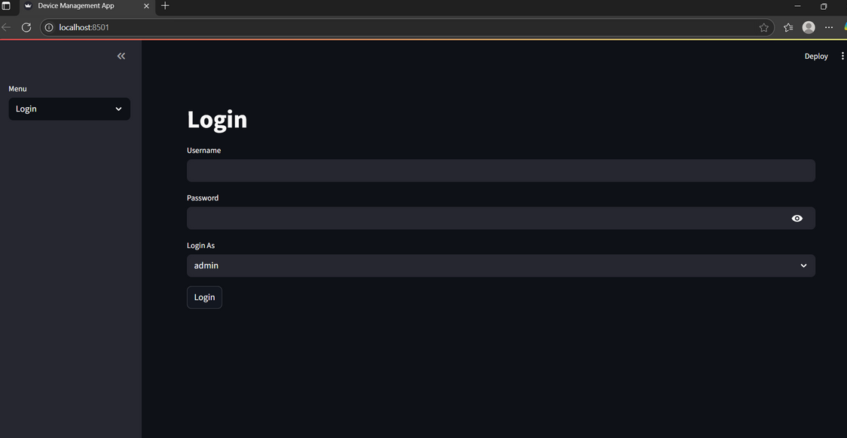
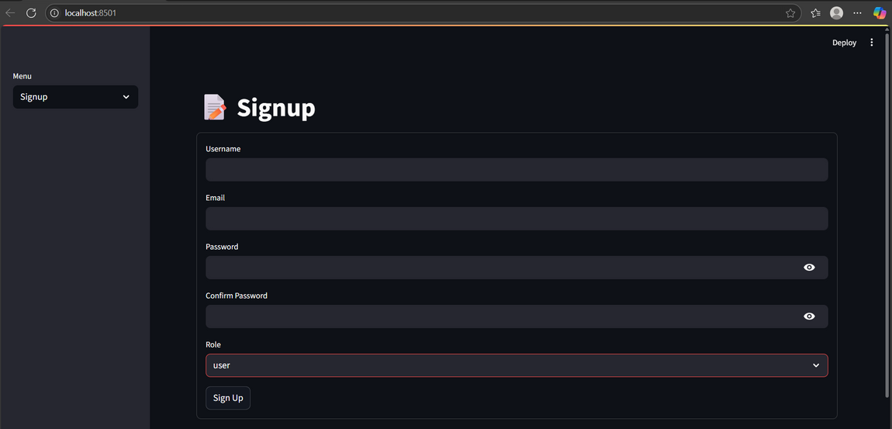
Application Screenshots (Part 1)
Login & Signup Page
Shows basic login/signup interface
Role-based login redirection

Slide 9
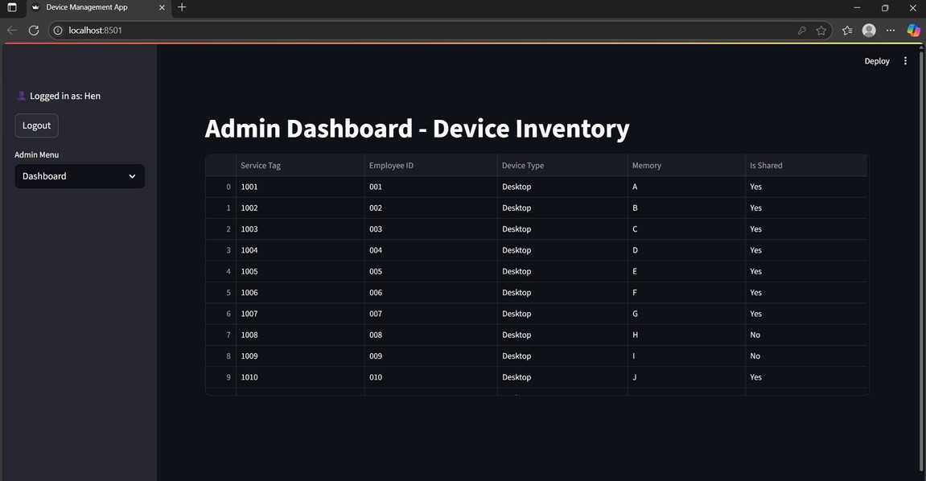
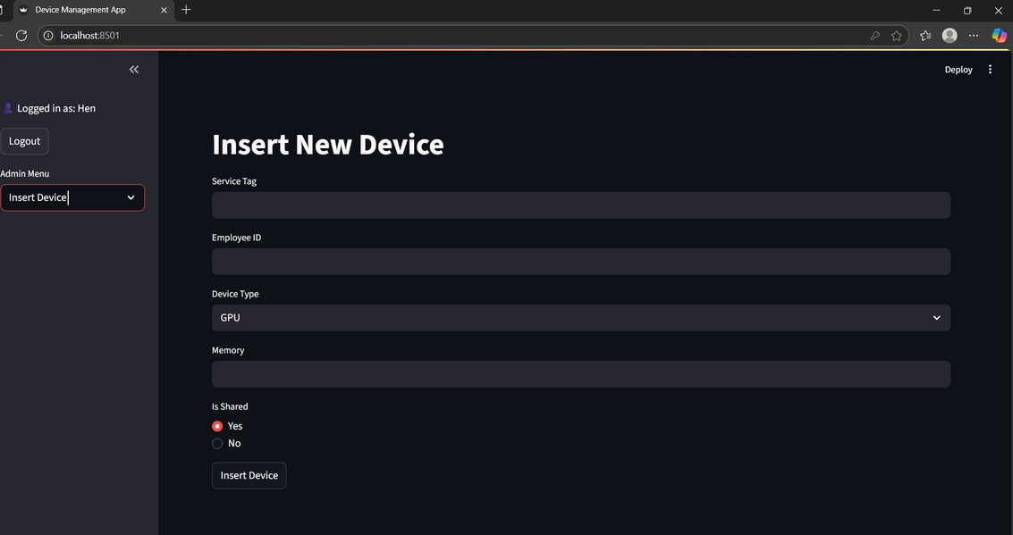
Application Screenshots (Part 1)
Admin Dashboard
Insert Page
View, Add, Update, Delete devices Filters and search functionality
Admin inputs Service Tag, Device Type, Memory Dropdown to choose sharing status

Slide 10
Application Screenshots (Part 1)
Delete Page
Update Page
Enables admin to remove a device using its service tag.
Automatically deletes linked employee ID from the user table.
Allows admin to modify device details like type, memory, and assigned employee ID.
Updates are reflected instantly in the dashboard and calendar.

Slide 11
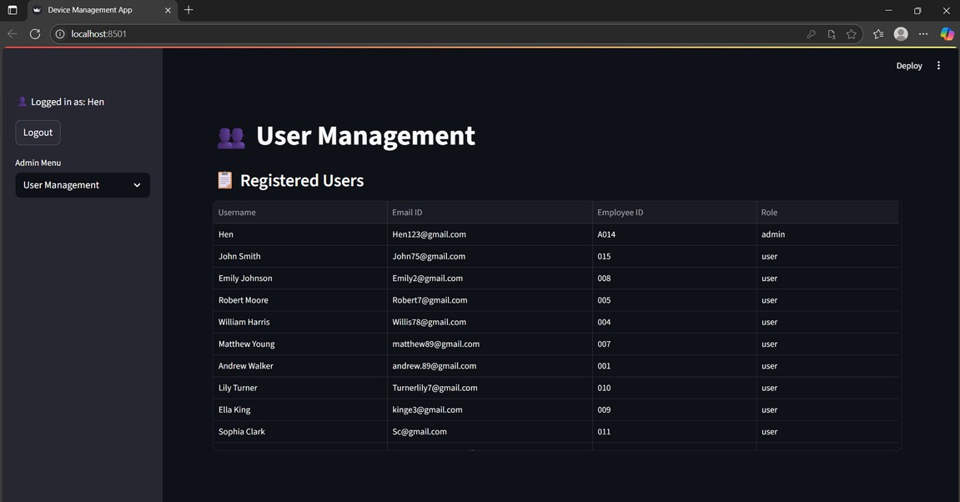
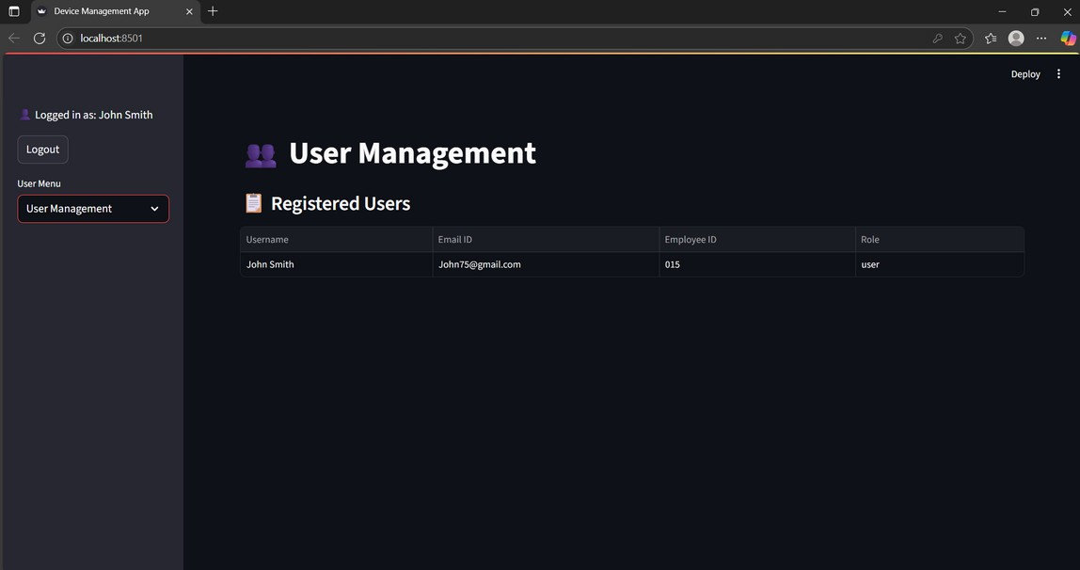
Application Screenshots (Part 2)
User Management Page
Admin Management Page
User Management Page
Admin: View and manage all users User: See only their assigned details

Slide 12
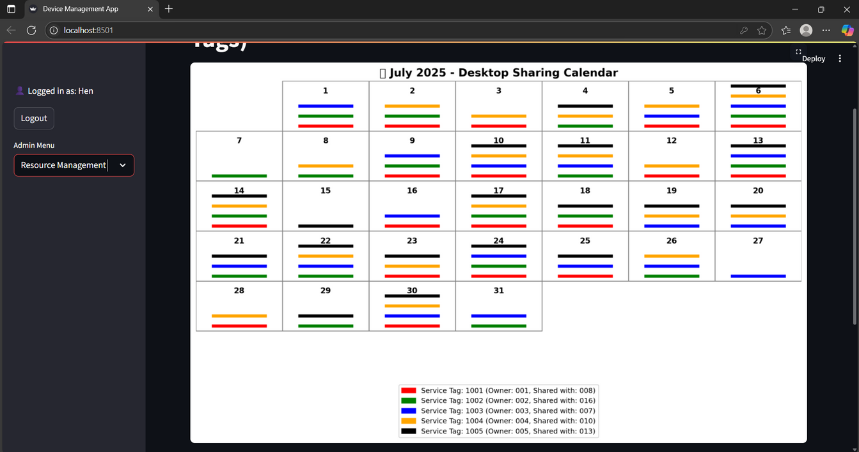
Application Screenshots (Part 2)
Calendar Page
Visual representation of shared desktops by employee ID Color-coded entries by device or employee

Slide 13
Results and Analysis
Successfully developed a functional and interactive system
Achieved non-repetitive ID generation logic
Device sharing logic aligned with 18-day allocation Desktops can be shared by multiple users over time Admin has total control over user and device data
Easy-to-navigate interface reduces training requirement Light database (DuckDB) simplifies setup and storage

Slide 14
Conclusion
This project simplifies internal IT asset management.
Reduces workload on admin staff with self-service dashboards.
Maintains data integrity through automatic field validation and unique assignments.
Potential future improvements: Email notifications for device assignments Search and filter options on calendar Multi-user device sharing alerts
Can be extended for managing other resources like laptops, printers, etc.

Slide 15
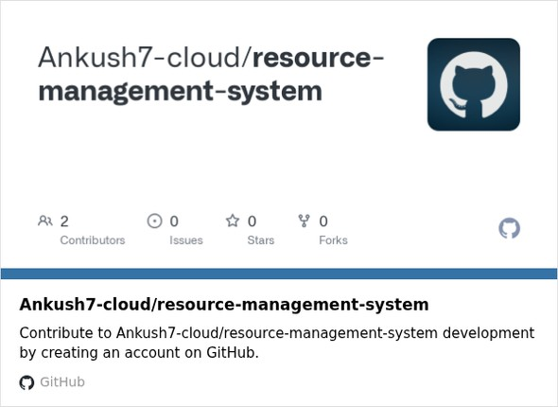
Thank You
Thank you for your attention!
Questions or feedback are welcome.
Project GitHub Link:

